Slide 1

Maps
LECTURE 19
Adding another tool to our visualization toolkit.
Spark 10, Spring 2024
Developed by students and faculty at UC Berkeley and Tuskegee University
data6.org/su23/syllabus/#acknowledgements-

Slide 2
Week 13
Announcements!
End of Semester Project will be posted at the end of the week (04/26/2024)
Due on the day of the final (5/9/24)
Homework 4 grades have been released on CatCourses

Slide 3
Today’s Roadmap
Homework #4 Cool Plots!
Motivation
Scatter Plot Maps
Choropleth Maps
Lecture 19, Spark 10, Spring 2024

Slide 4
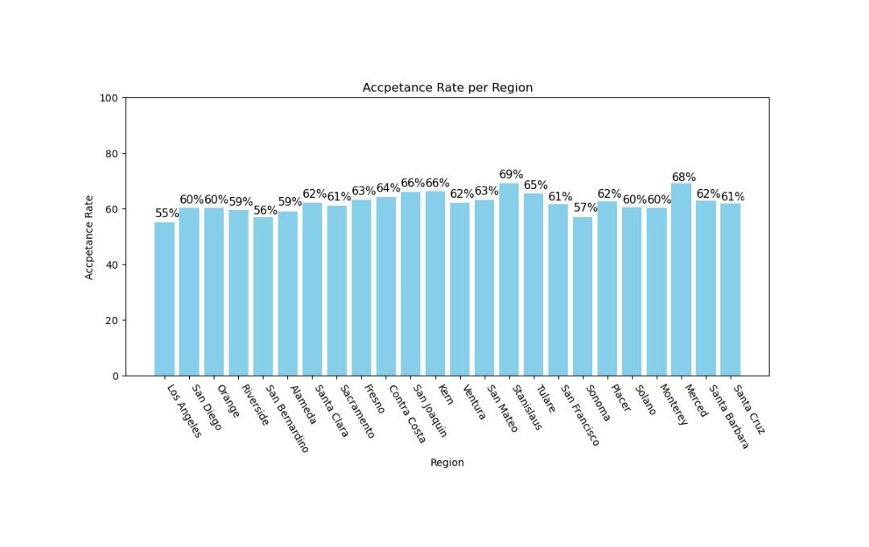

Slide 5
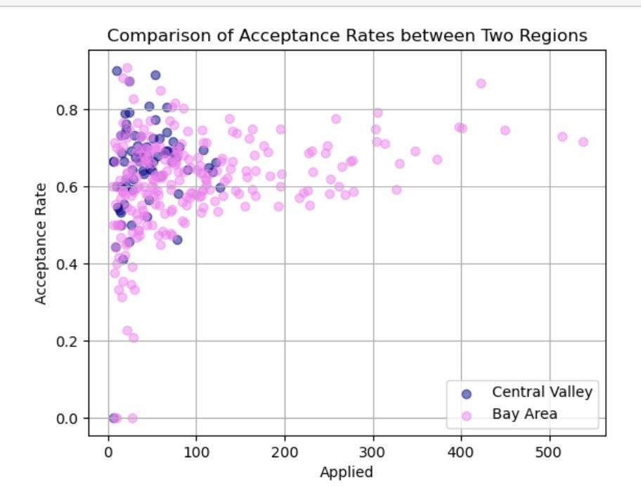

Slide 6
Motivation
➤
1. Motivation
2. Scatter Plot Maps
3. Choropleth Maps

Slide 7

(Hank Green)

Slide 8
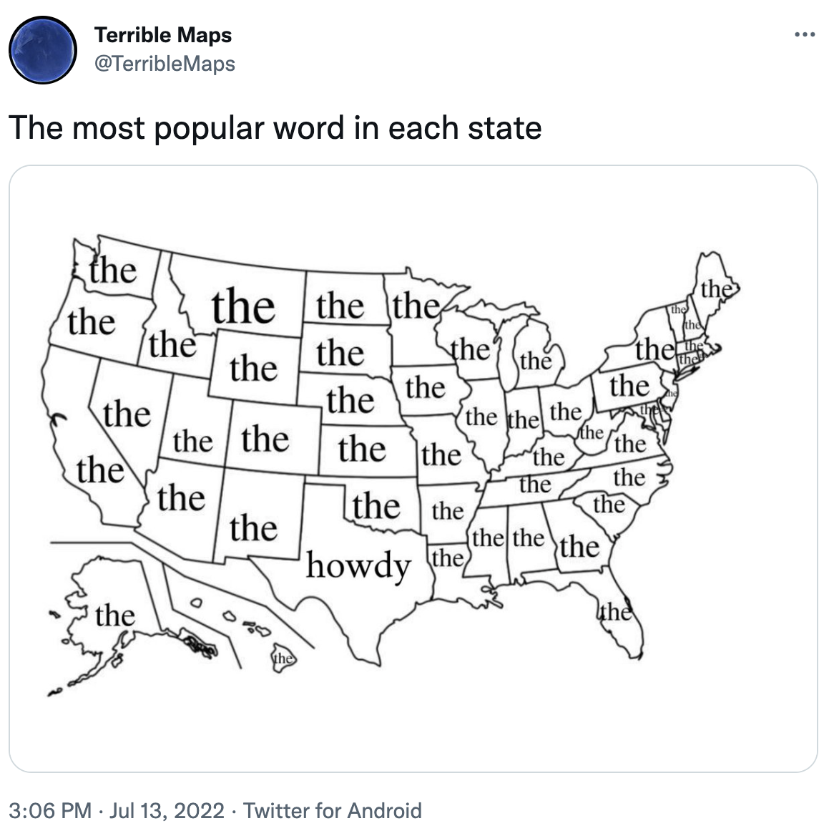
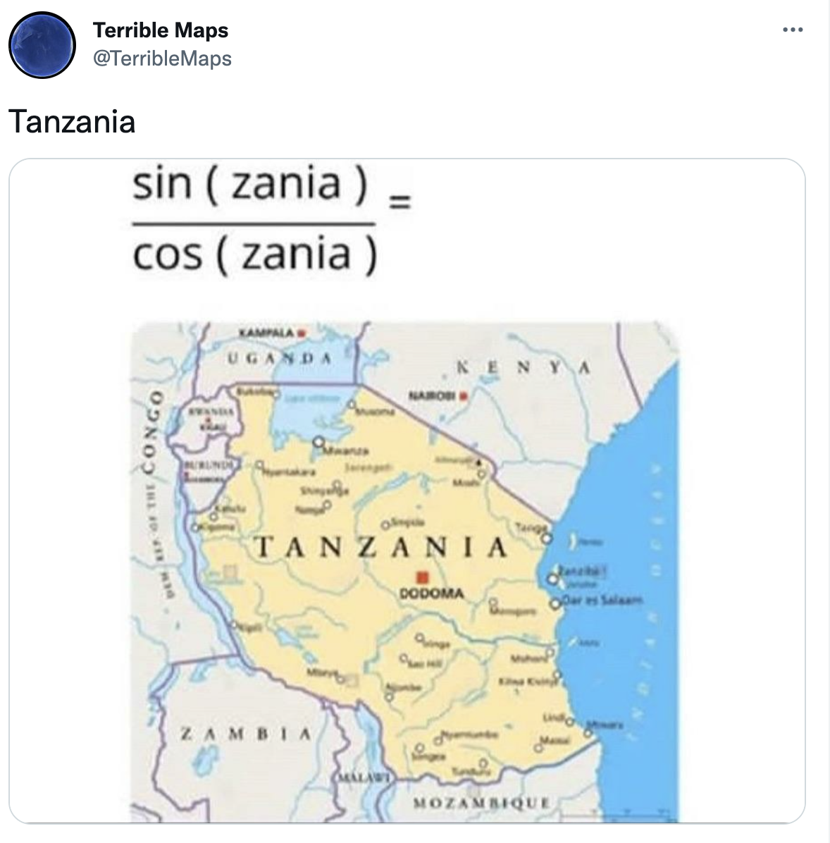
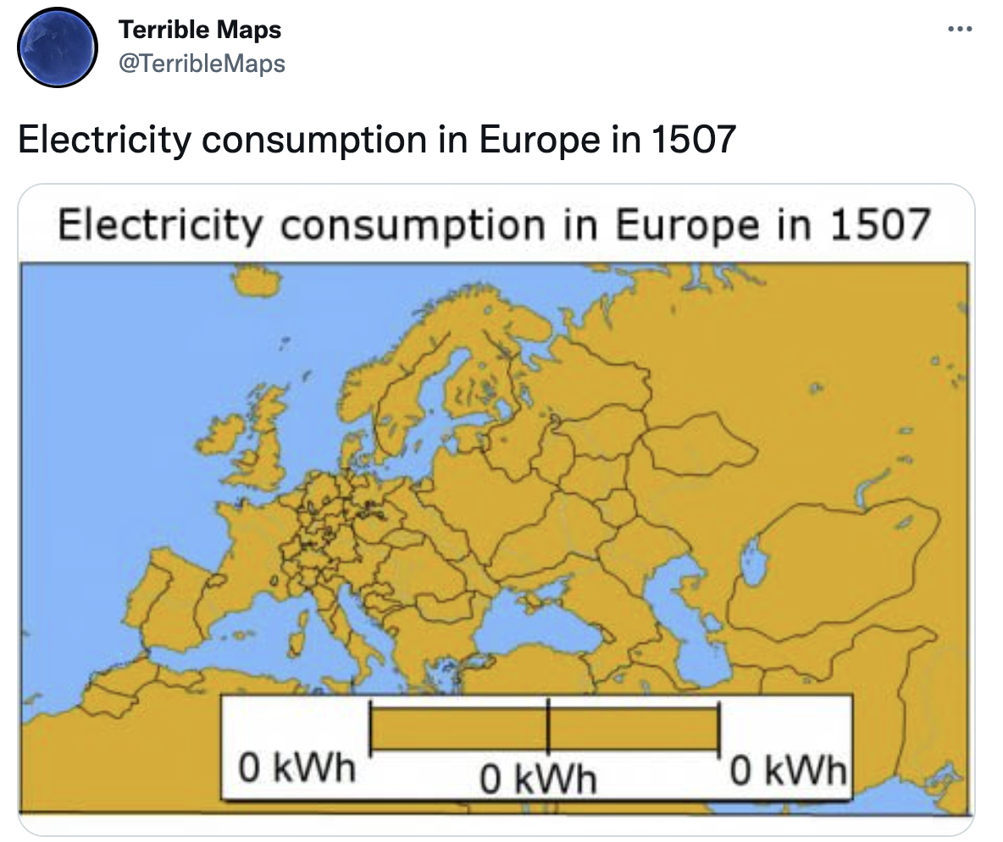
@TerribleMaps

Slide 9
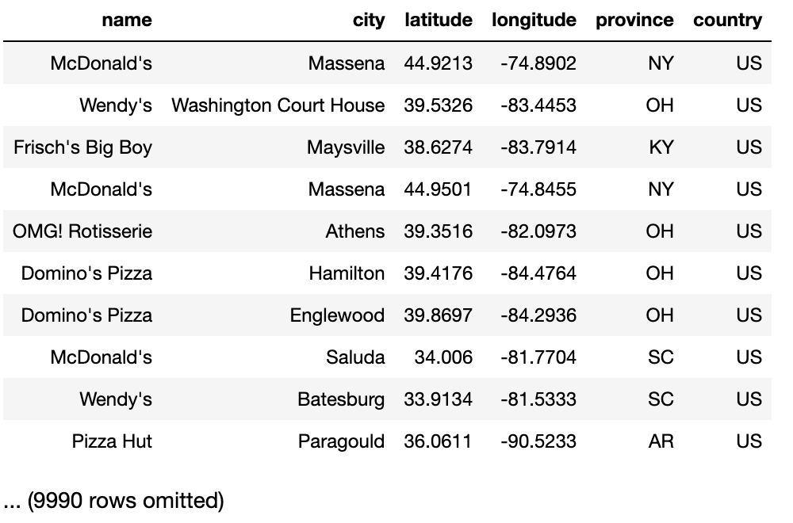






Today’s Data
Over 10,000 fast food restaurants from across the US, with over 500 unique fast food chains.
from Kaggle

Slide 10
Quick Review
1. Motivation
2. Scatter Plot Maps
3. Choropleth Maps
➤

Slide 11
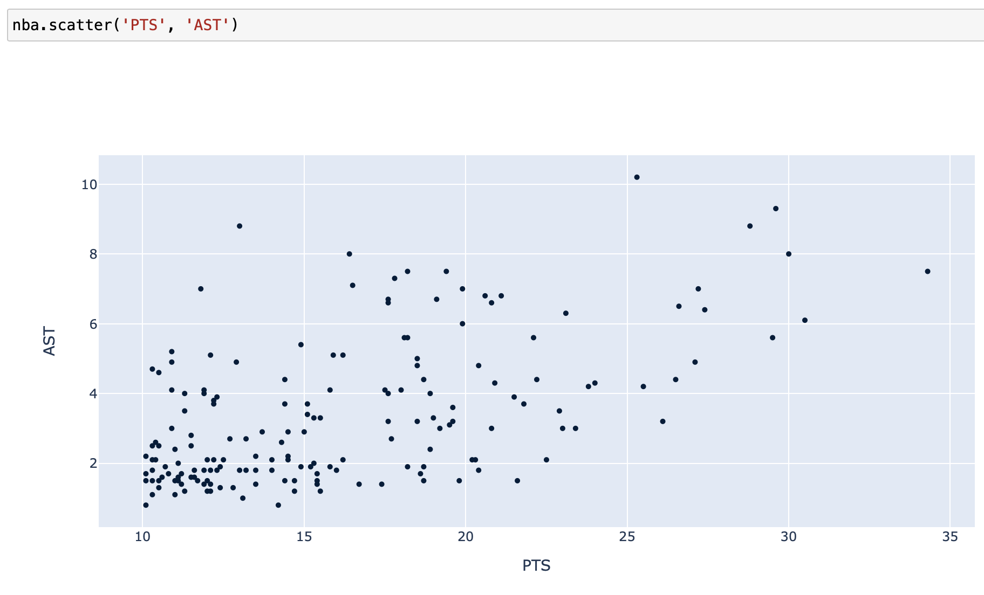
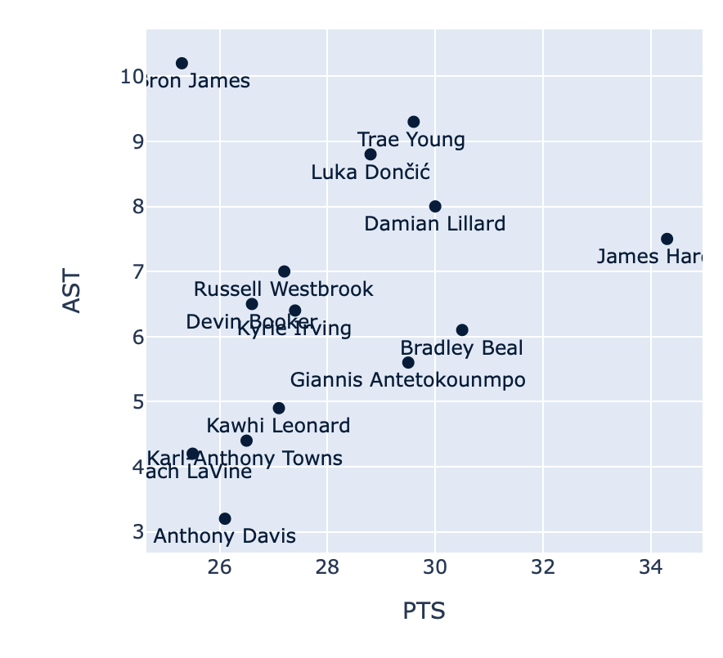
Scatter Plots
The method
t.scatter(column_for_x, column_for_y)
creates a scatter plot using the specified columns. Both columns must contain numerical values.
Optional arguments, in addition to color column_for_x, column_for_y:
group (str): points will be colored according to category in this categorical column.
labels (str): points will be labeled according to their value in this column.

Slide 12
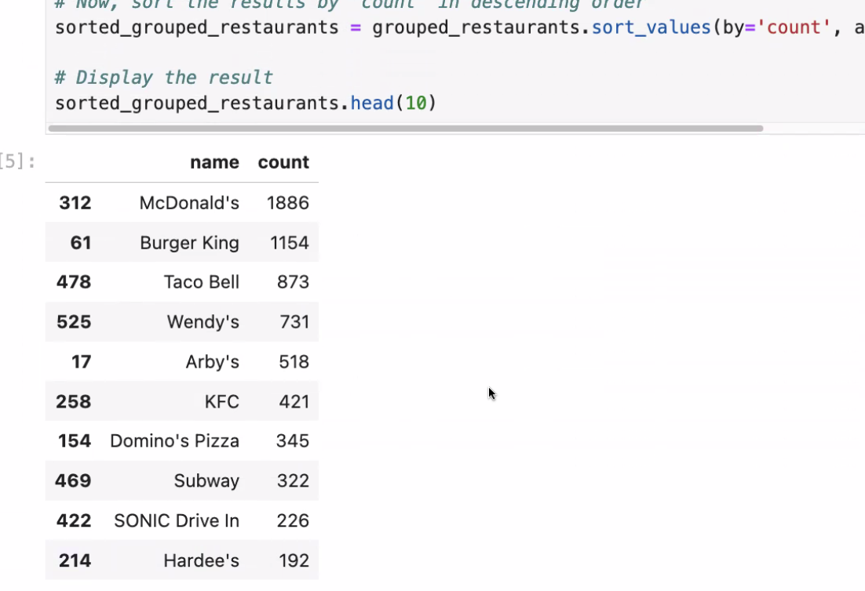
.groupby()
The term “group” in data science is most commonly associated with data aggregation and disaggregation.
Aggregation: A process in which information is gathered and expressed in collective or summary form.
Disaggregation (aka disentanglement): A process of taking aggregated data and breaking it down into smaller information units.
The method t.groupby(column) counts the number of rows for each unique value in column, and returns a two-column table with the results.

Slide 13
Scatter Plot Maps
1. Motivation
2. Scatter Plot Maps
3. Choropleth Maps
➤

Slide 14
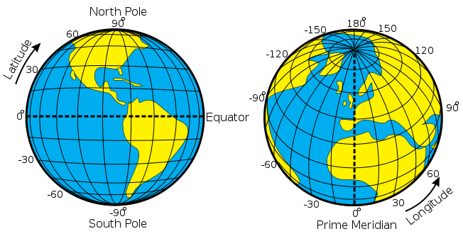
Latitude and Longitude
Any point on Earth can be described by its latitude and longitude.
Latitude can be thought of as the “y” or “vertical” position.
Longitude can be thought of as the “x” or “horizontal” position.
When describing a location, latitude always comes before longitude.

Slide 15
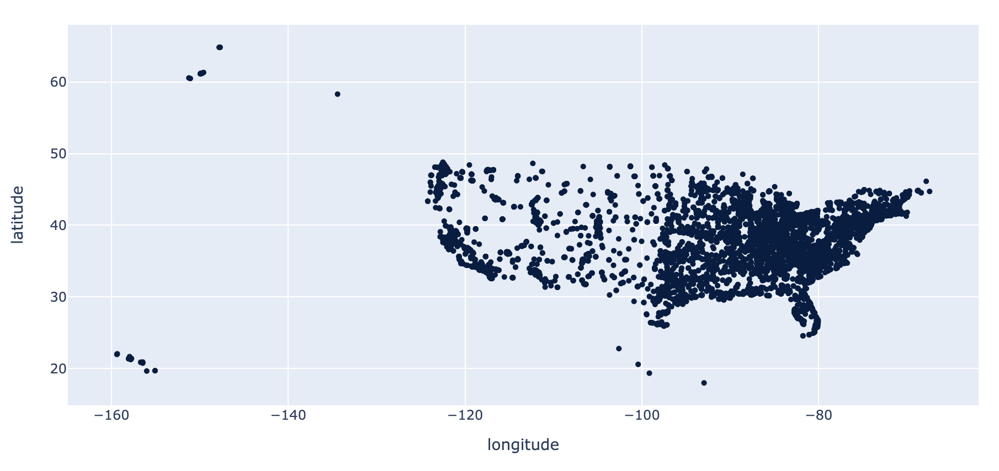
What’s Wrong with a Scatter Plot?

Slide 16
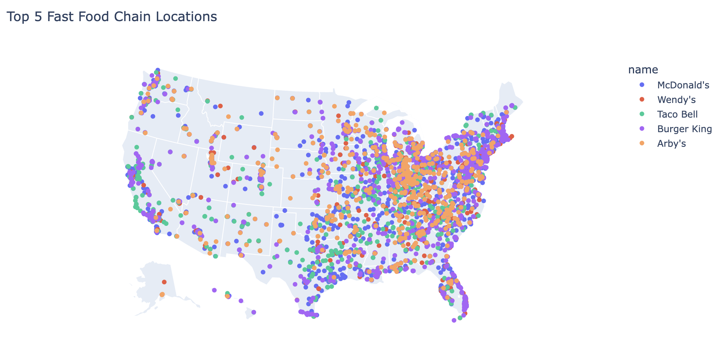
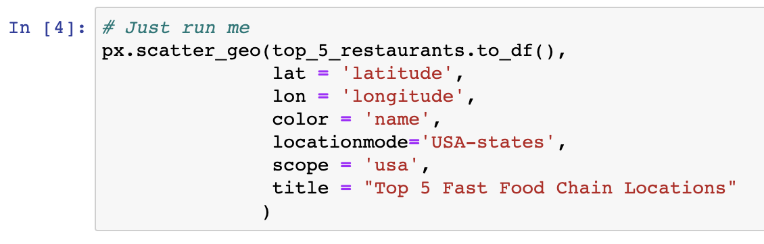
Scatter Plot Maps
Scatters Plot + Map = ❤️
When we want to visualize the geographic locations of a lot of data points, it's often helpful to start with a scatter plot map.
Scatter plots with geographic maps
Help you visualize geographic locations in relation to cities, states, and countries.
Use px.scatter_geo(df, lat, lon)
data frame, latitude, longitude

Slide 17

A Side Note
Plotly
For our maps we will use a Python library called Plotly (px in your notebooks). Plotly is a commonly used visualization library and is really useful for creating maps.
Plotly can be quite confusing and difficult to understand
The documentation is really helpful
We do not expect you to memorize/remember any Plotly syntax. This is purely for fun.

Slide 18
Optional Arguments
We can customize our scatter plot maps by specifying the following arguments:
Argument | Example | Behavior
color | color = ‘name’ | The colors of points on the map are assigned based on their category in the name column of the data frame
locationmode | locationmode = ‘USA-states’ | Specifies which map to display. We usually set this to ‘USA-states’ to show a state map of the US
scope | scope = ‘usa’ | Specifies the scope of the map (i.e. what is visible). Setting scope to ‘usa’ zooms the map in just to the US
title | title = ‘My Map’ | Sets the title of the map

Slide 19
Questions?

Slide 20
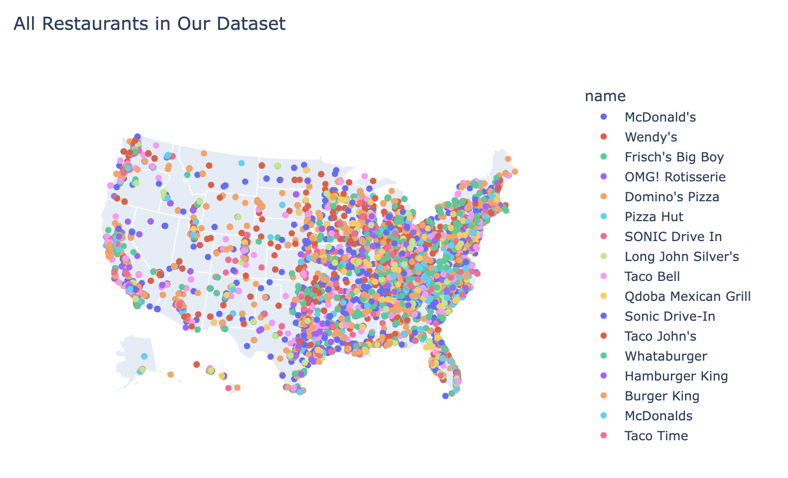
Example: All Restaurants
Just because we can plot all restaurants in our dataset doesn’t mean we should.

Slide 21
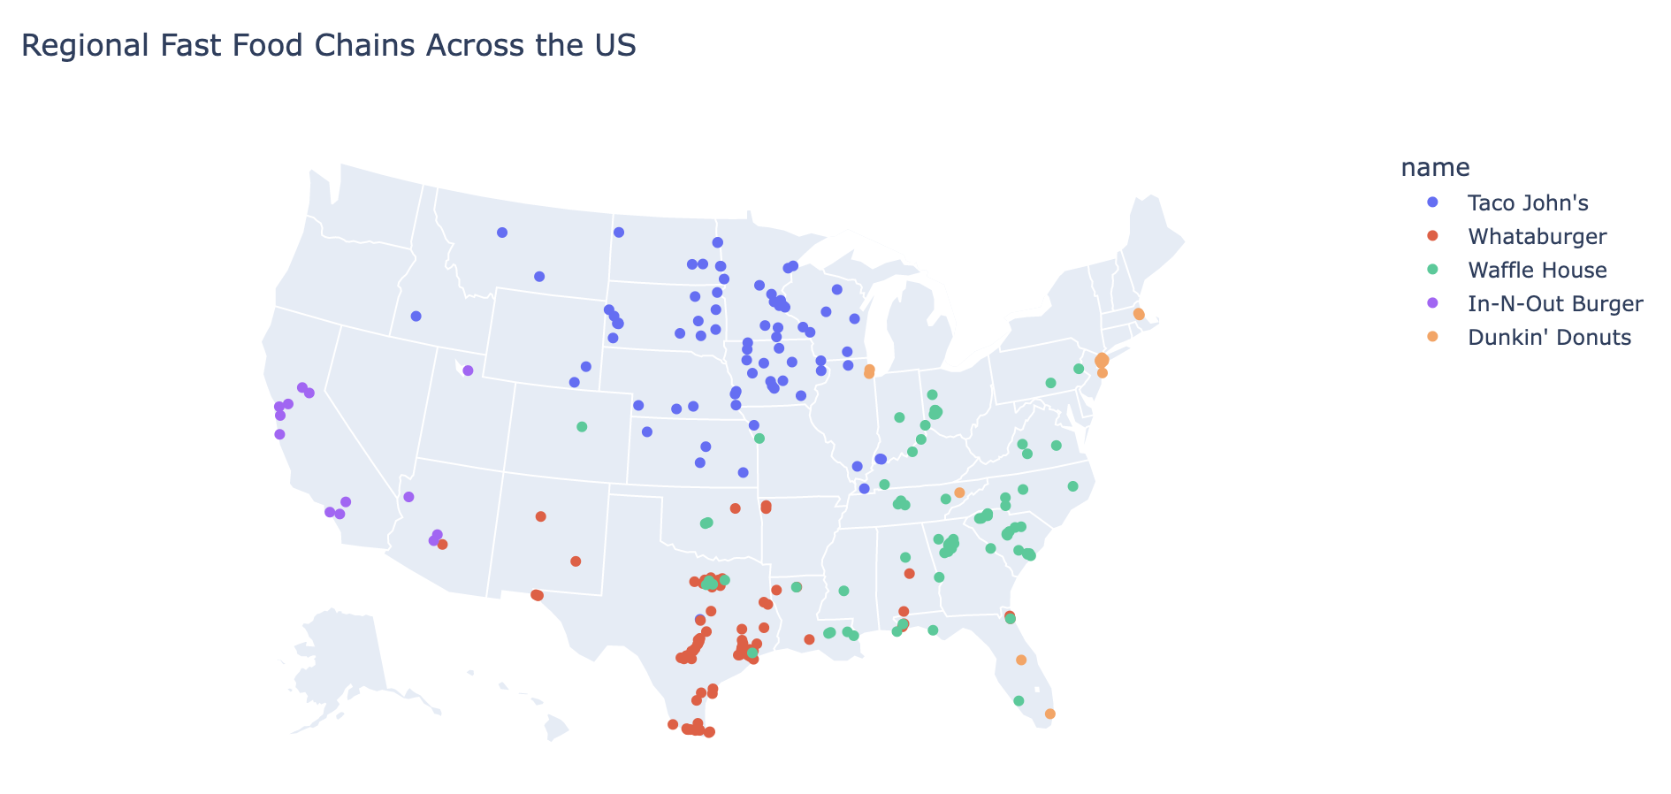





Example: Regional Chains

Slide 22
Choropleth Maps
1. Motivation
2. Scatter Plot Maps
3. Choropleth Maps
➤

Slide 23
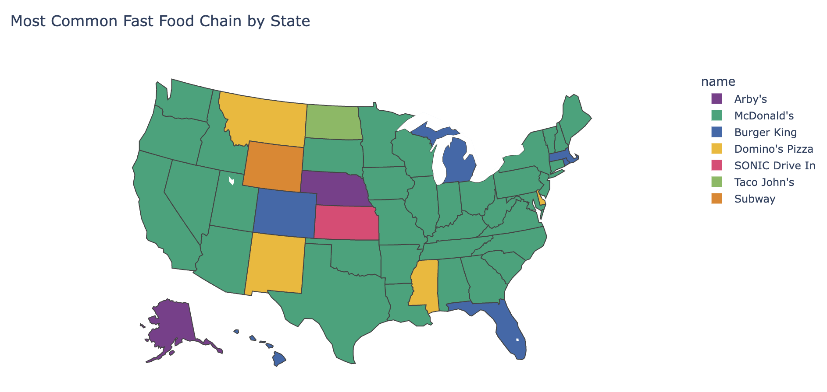
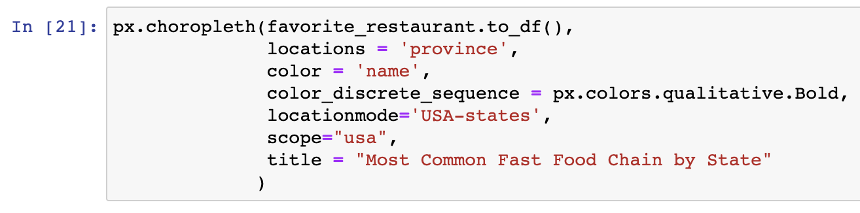
Choropleth Maps
Aggregation!
Choropleth maps are useful for visualizing numerical variables across different states or countries. In this sense they are analogous to bar charts, since they encode one categorical variable (state or country) and one numerical variable.
Use px.choropleth(df, locations)
data frame, state abbreviations

Slide 24
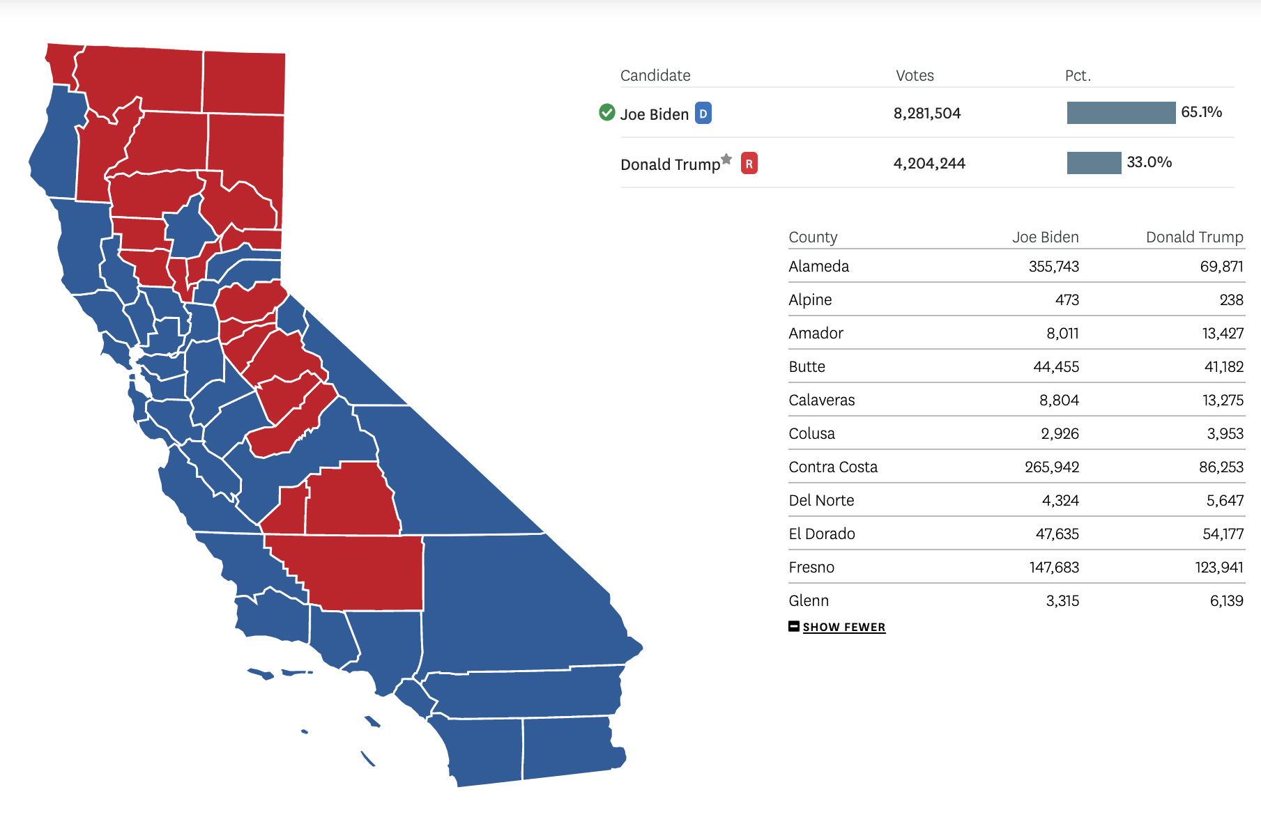
Example: Election Mapping
(SF Chronicle)

Slide 25
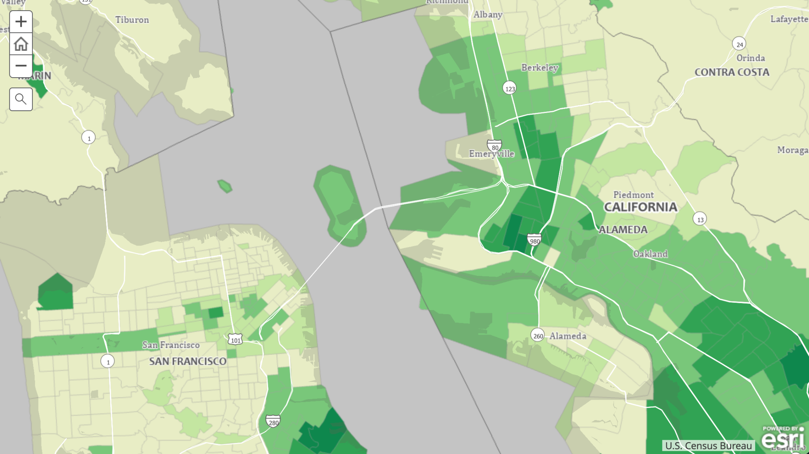
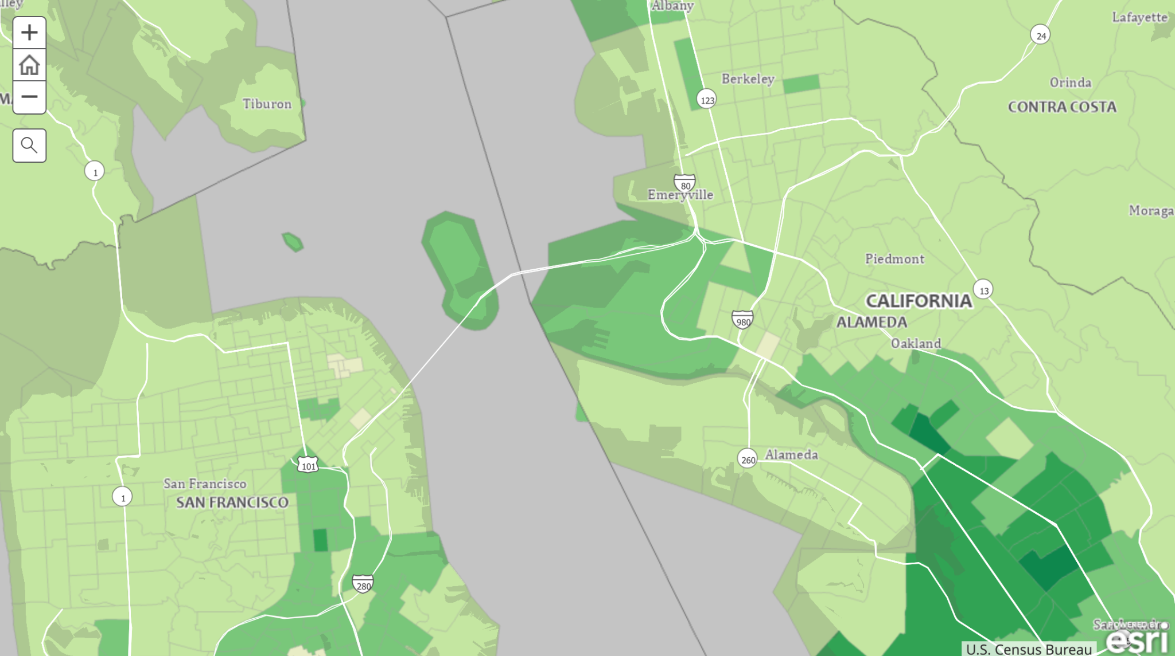
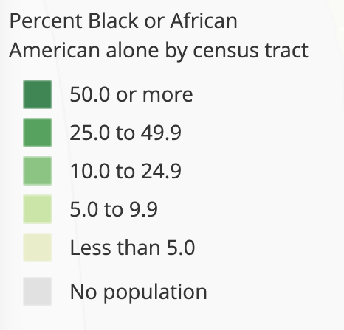
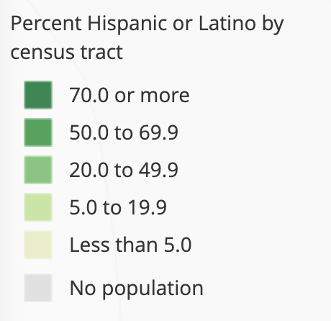
Example: Census Data
Percent Black or African American
Percent Hispanic or Latino
2020 US Census Demographic Data

Slide 26
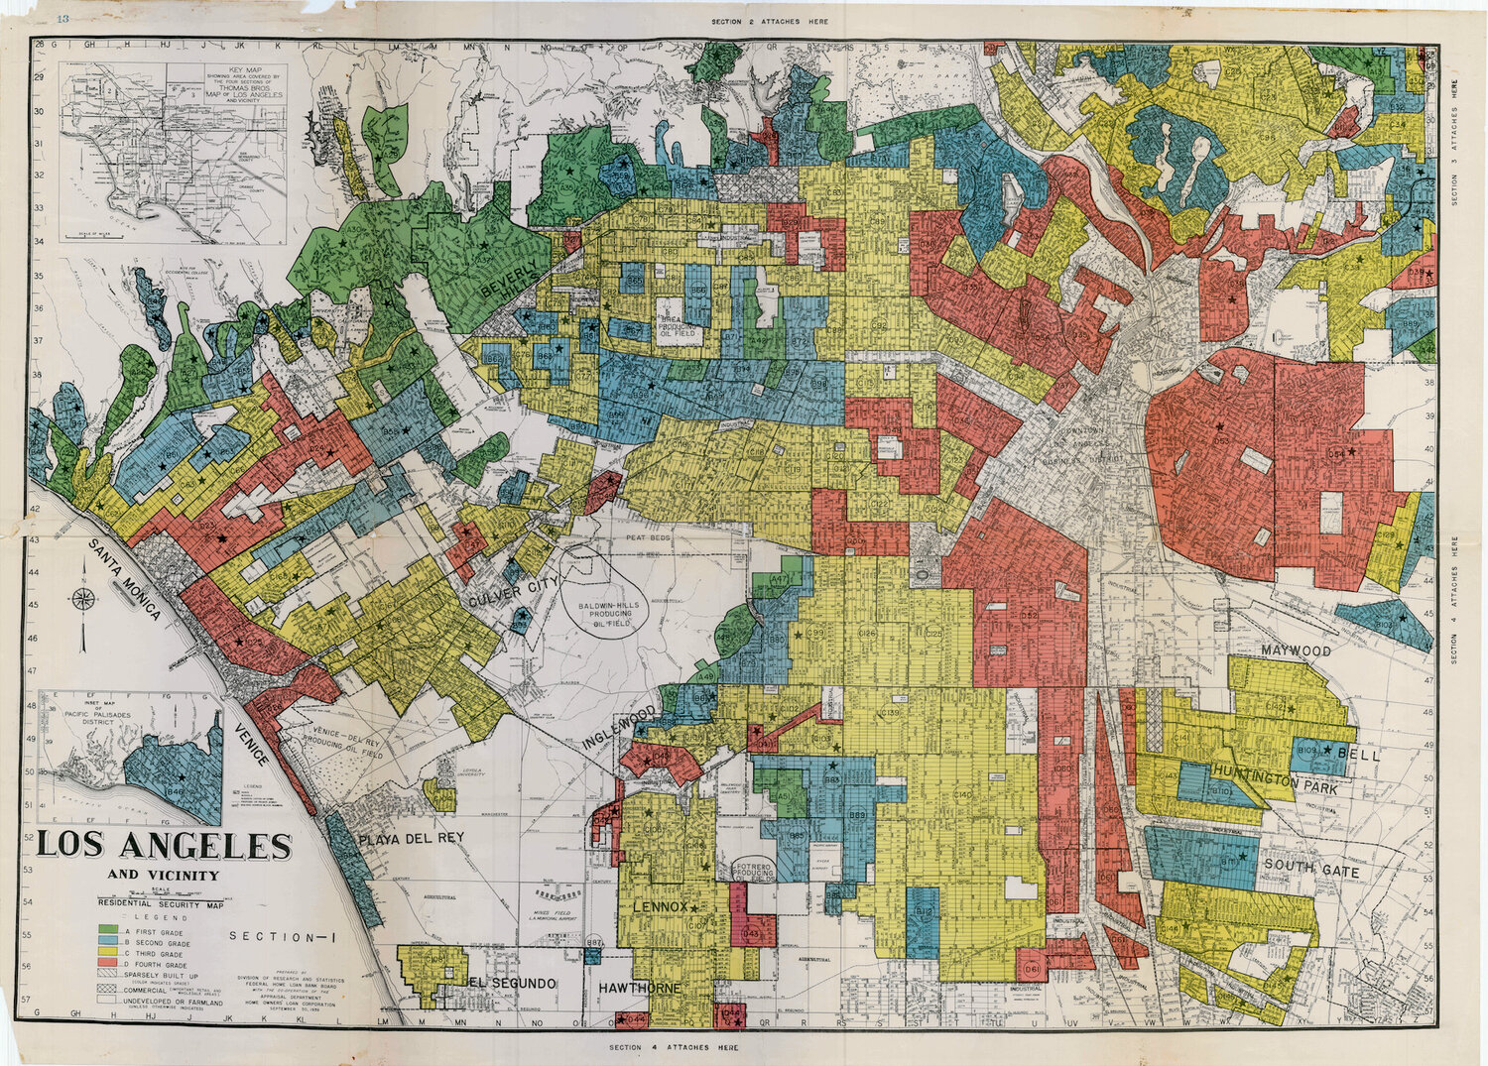
Example: Redlining
LA “Residential Security Map” from The Color of Law (Rothstein)

Slide 27
Plotly Choropleth Maps
We can customize our choropleth maps by specifying the following arguments:
Argument | Example | Behavior
color | color = ‘name’ | The colors of points on the map are assigned based on their category in the name column of the data frame
color_discrete_sequence | color_discrete_sequence = px.colors.qualitative.Bold | Specifies the color palette to use for coloring the categories.
locationmode | locationmode = ‘USA-states’ | Specifies which map to display. We usually set this to ‘USA-states’ to show a state map of the US
scope | scope = ‘usa’ | Specifies the scope of the map (i.e. what is visible). Setting scope to ‘usa’ zooms the map in just to the US
title | title = ‘My Map’ | Sets the title of the map

Slide 28
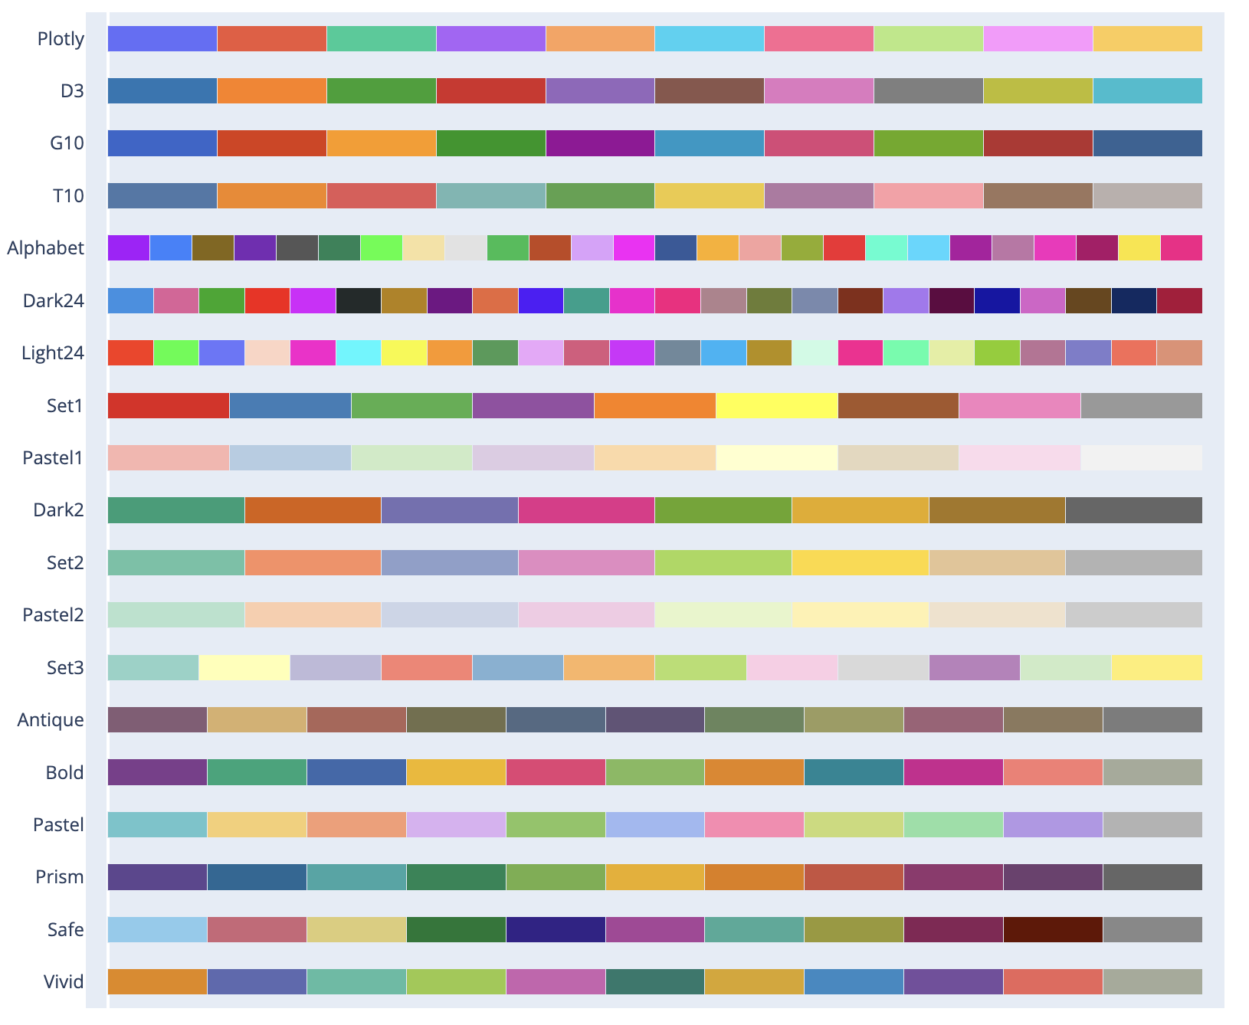
Colors
There are a lot of options to choose from for color palettes.
px.colors.qualitative.D3
px.colors.qualitative.Set2
…
What are some considerations we should keep in mind when choosing a color palette?

Slide 29
Example: Favorite Chains

Slide 30
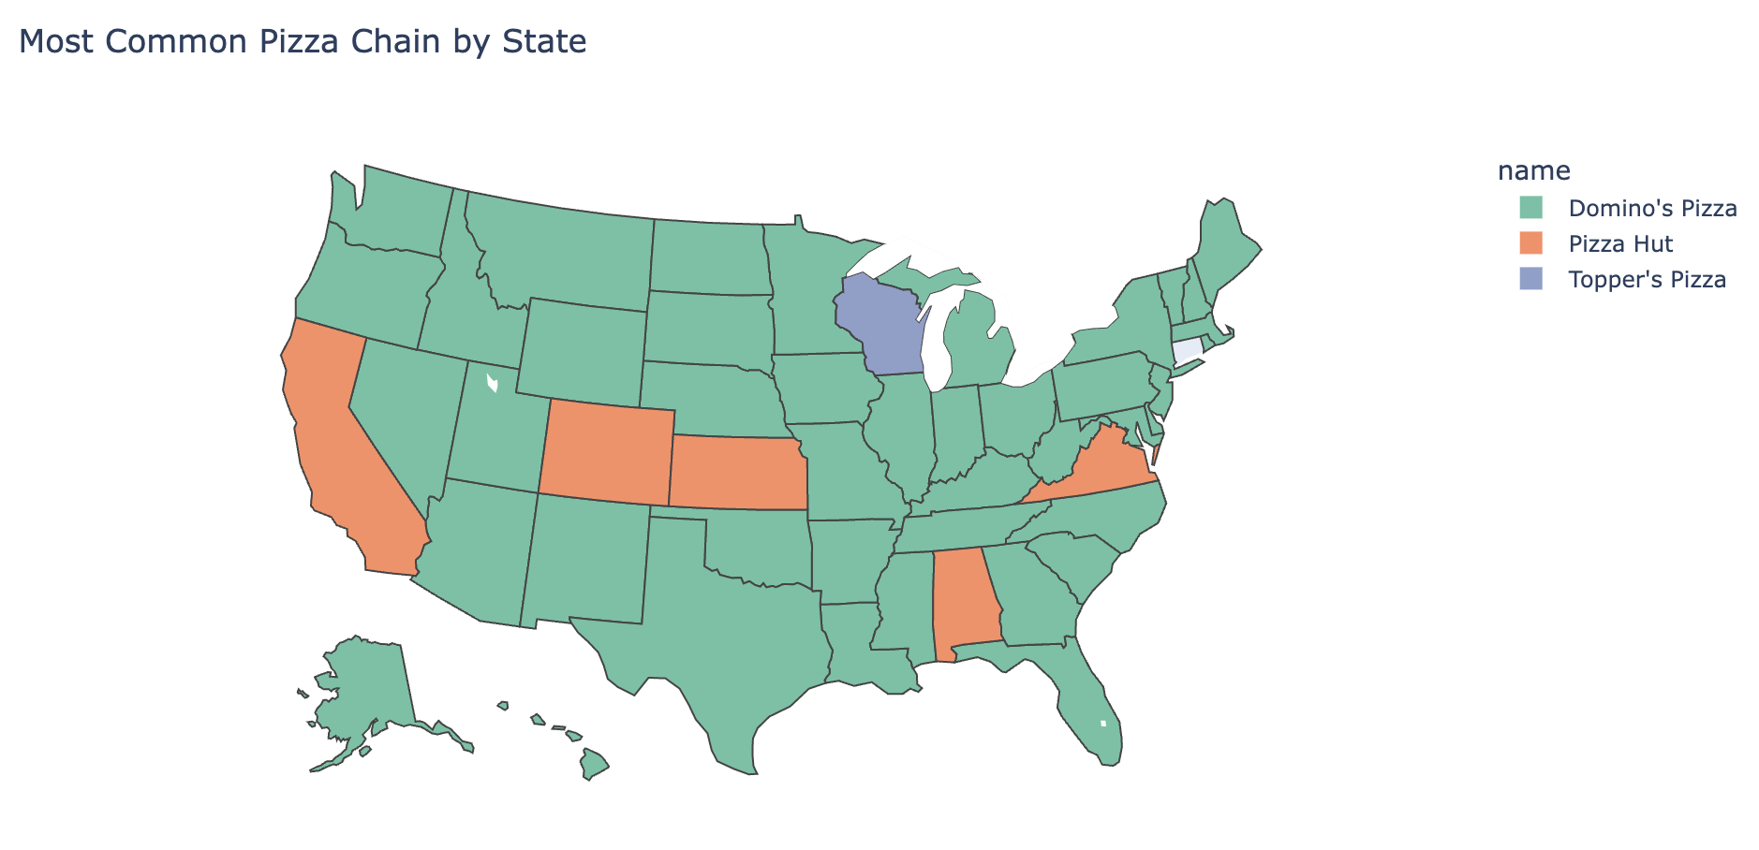
Example: Pizza Chains

Slide 31
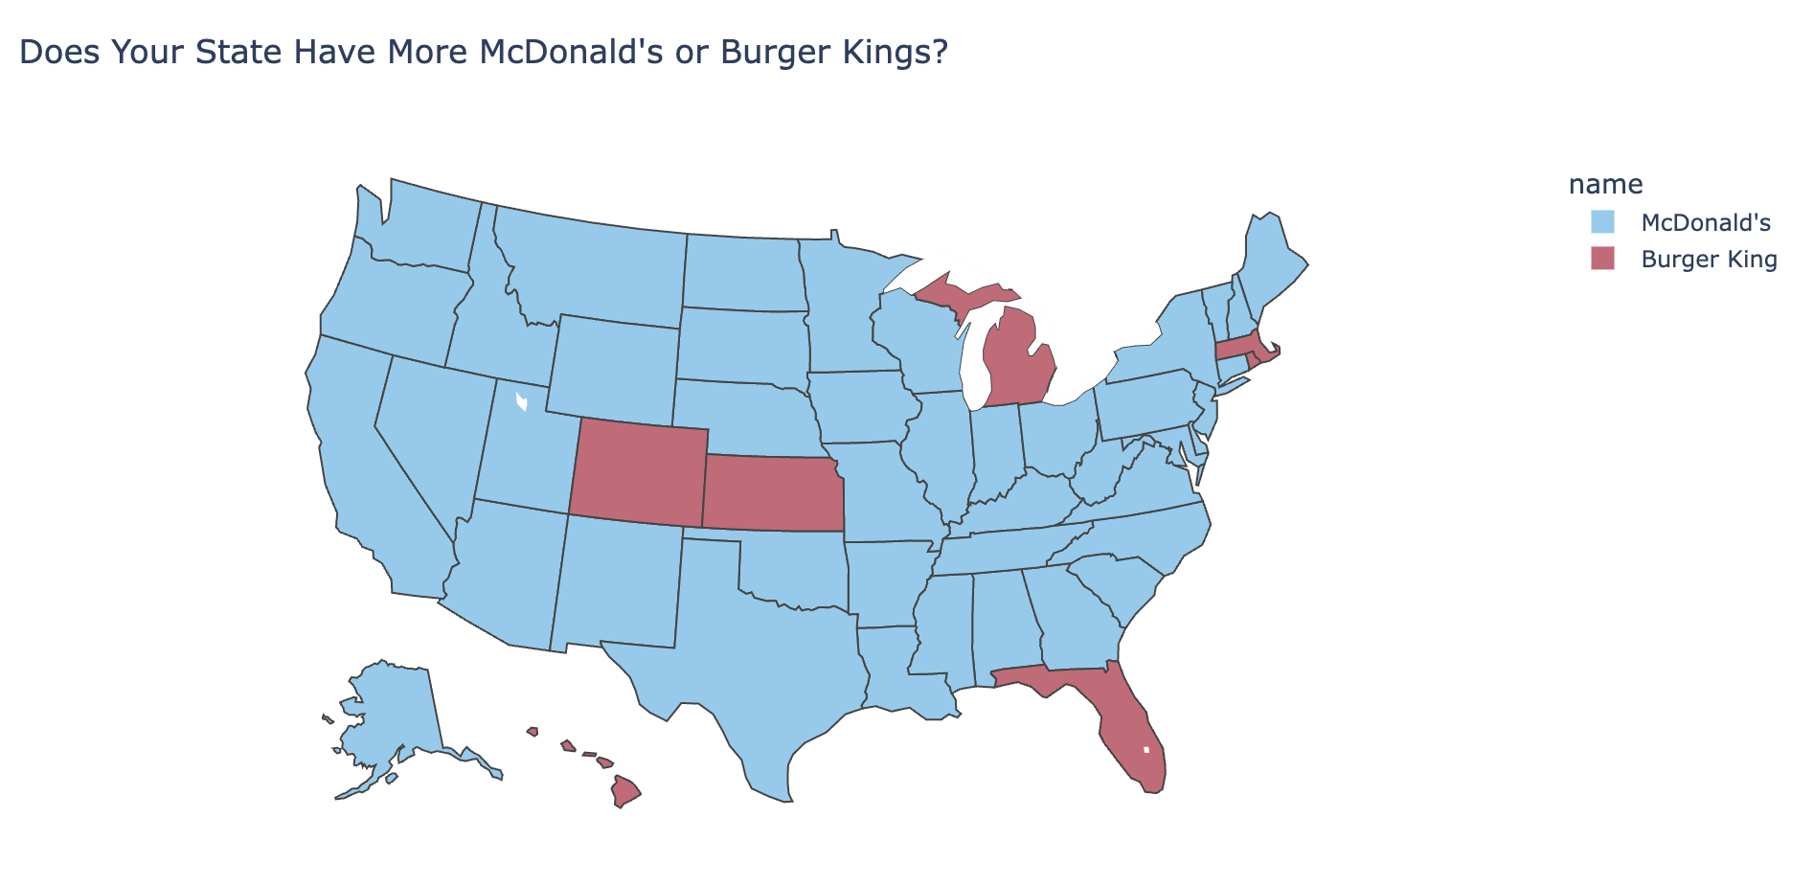
Example: McDonald’s vs. Burger King

Slide 32
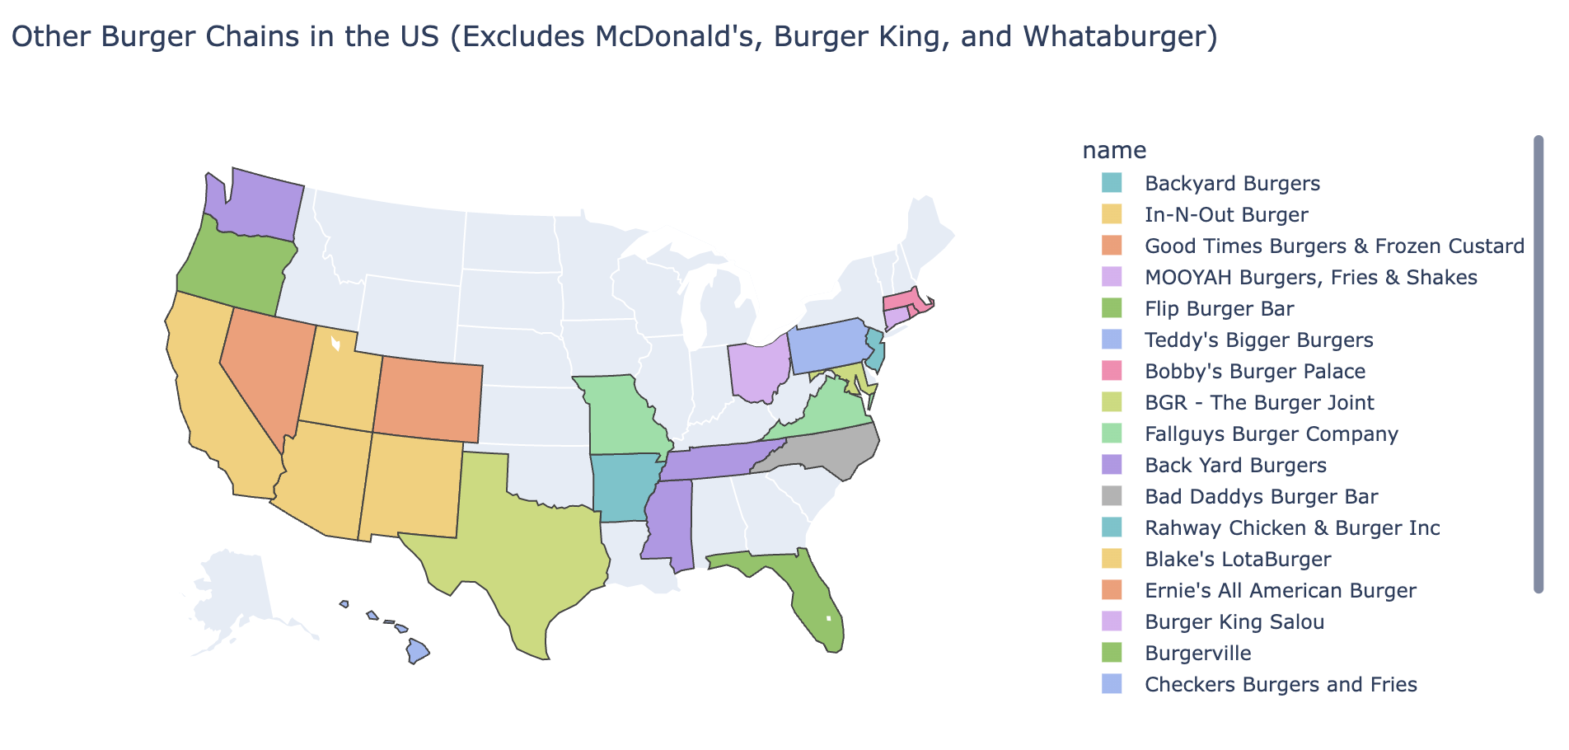
Example: Local Burger Chains

Slide 33
Questions?

Slide 34
In Conclusion…

Slide 35
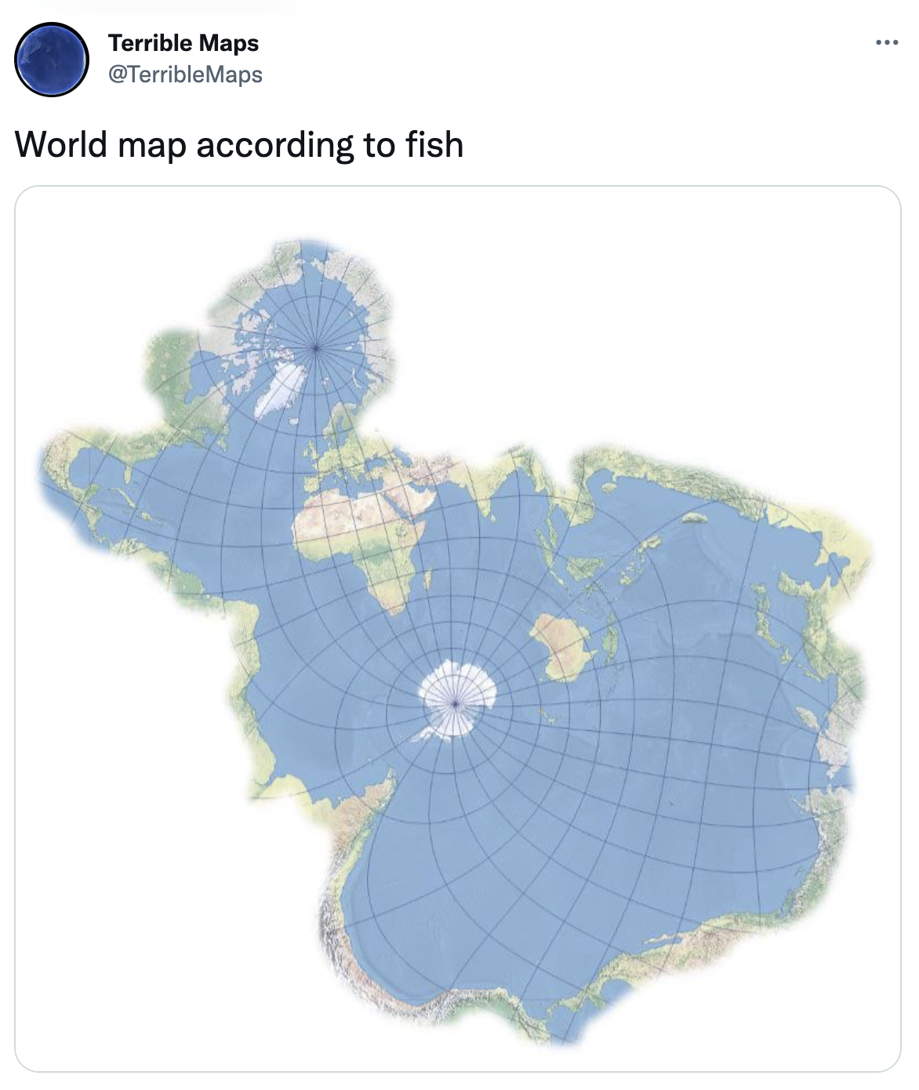
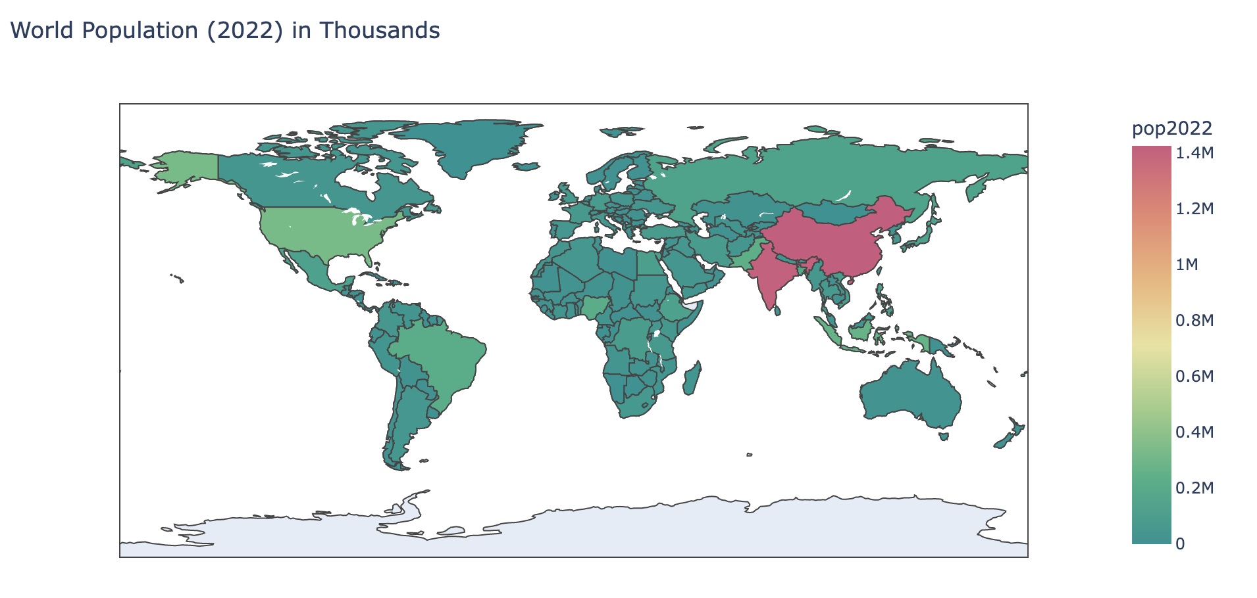
Summary
Scatter plot maps are useful when we want to visualize the geographic locations of a lot of data points, but it is really easy to overcrowd our maps
Choropleth maps allow us to visualize data aggregated by county, state, or country
Plotly is a very powerful mapping/visualization library, but you’re not expected to be an expert at it.
Map wisely!

Slide 36
Recap
Next Time
Maps
Scatter maps
Choropleth maps

Slide 37
Week 13
Announcements!
End of Semester Project will be posted at the end of the week (04/26/2024)
Due on the day of the final (5/9/24)
Homework 4 grades have been released on CatCourses

